Slide 1
Олигомерные Trochozoa

Slide 2
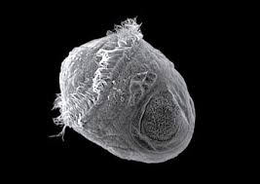
Trochozoa

Slide 4
Annelida = ларвальное + постларвальное тело

Slide 5
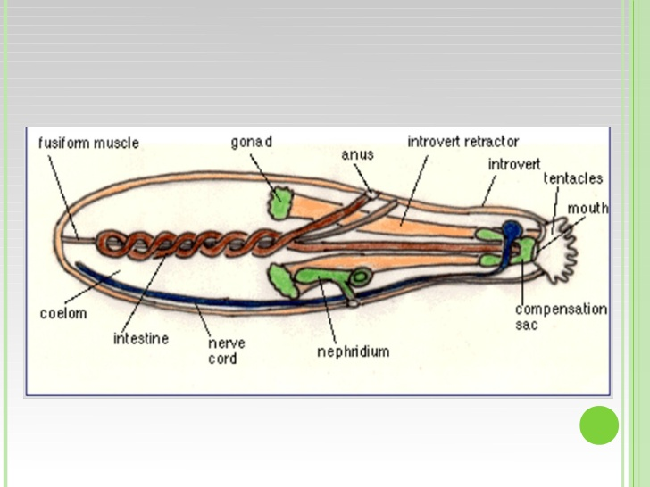
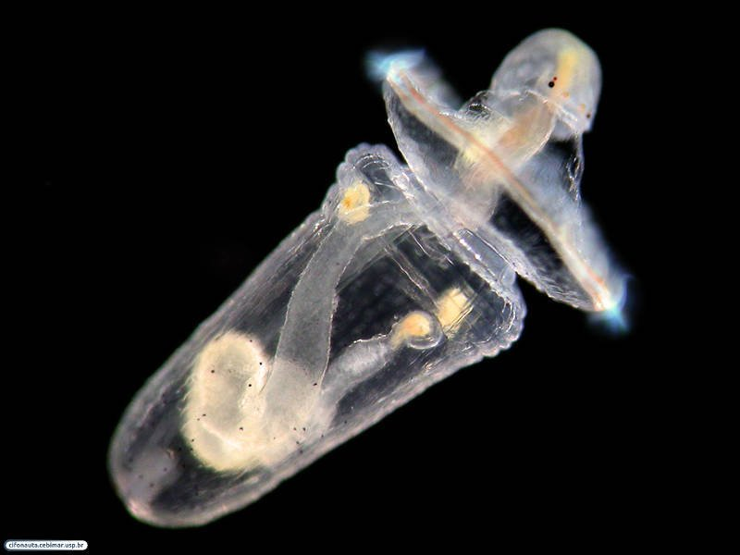
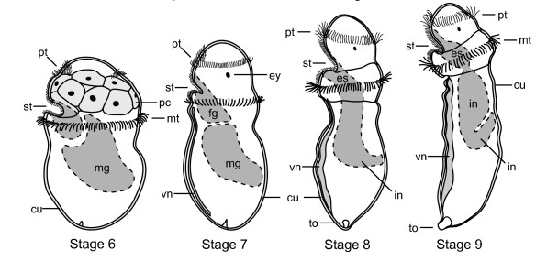
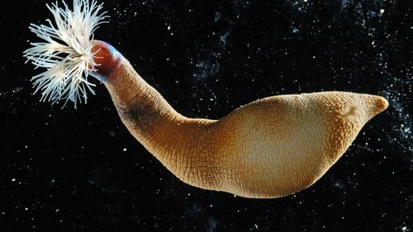
Sipunculida.
Пелагосфера

Slide 6
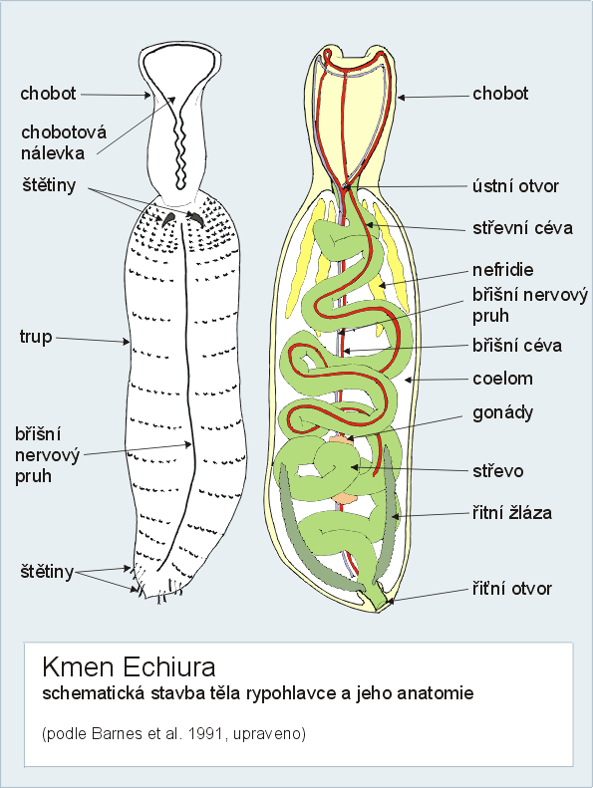
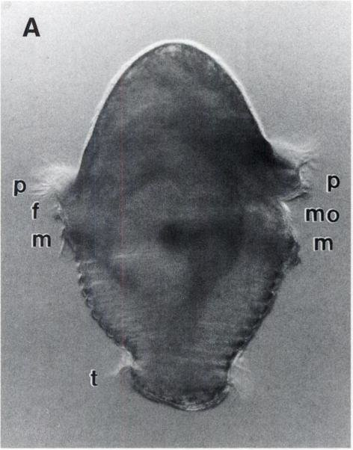
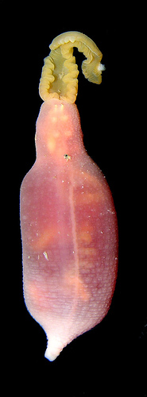
Echiurida.

Slide 7
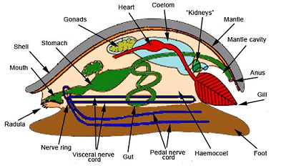
Mollusca.

Slide 8
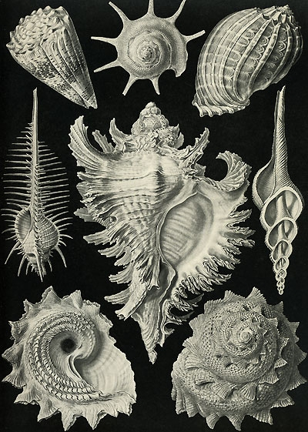
Mollusca

Slide 9
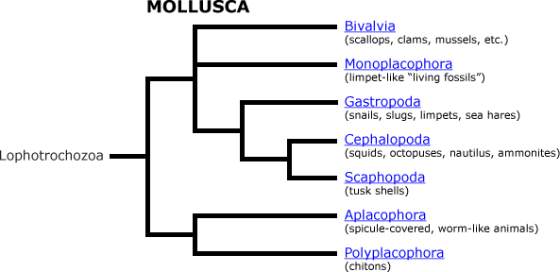
Classification
There are numerous approaches to mollusks classification

Slide 10
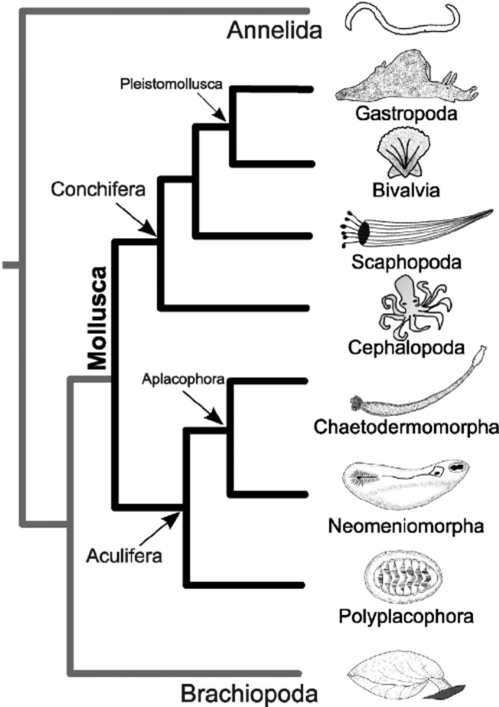

Slide 11
Classification
Subphyllum Amphineura
Class Caudofoveata
Class Solenogastres
Class Polyplacophora
Subphyllum Conchifera
Class Monoplacophora
Class Gastropoda
Class Cephalopoda
Class Bivalvia
Class Scaphopoda

Slide 12
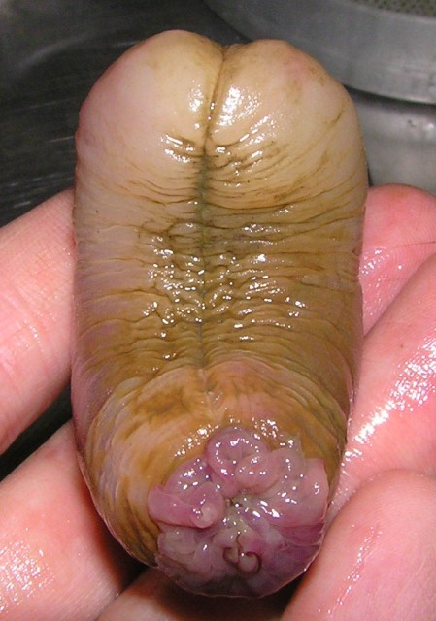
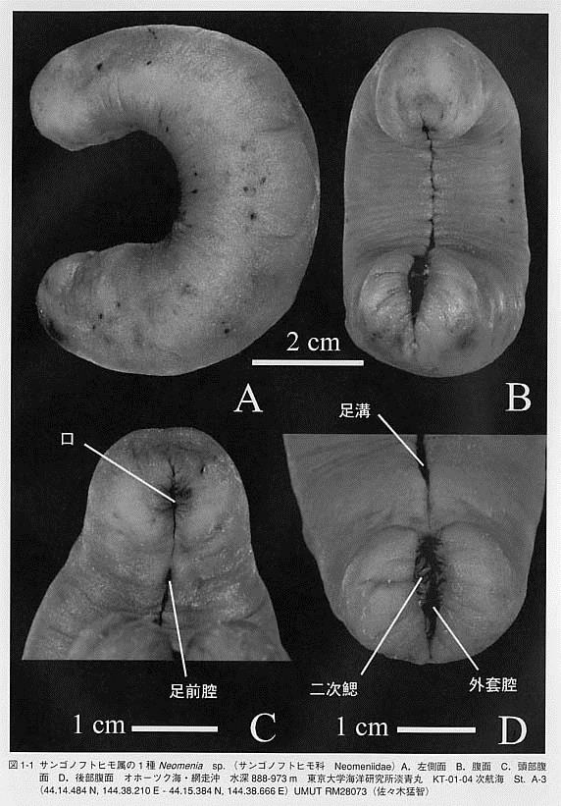
Subphyllum Amphineura
Solenogastres (180 species)
We will not find them
From http://olnud.livejournal.com

Slide 13
Subphyllum Amphineura
Caudofoveata (150 species)
We will find a lot of them

Slide 14
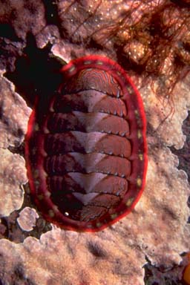
Subphyllum Amphineura
Polyplacophora (1000 species)
We will find them on hard substrates

Slide 15
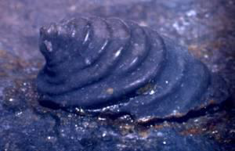
Subphyllum Conchifera
Monoplacophora (29 species)
Exactly we will not find them

Slide 16
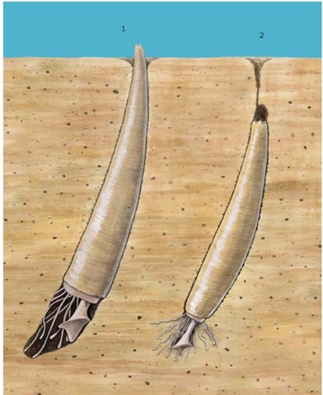
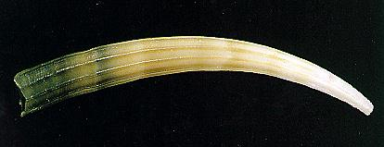
Subphyllum Conchifera
Scaphopoda (500 species)
I hope we will find them

Slide 17
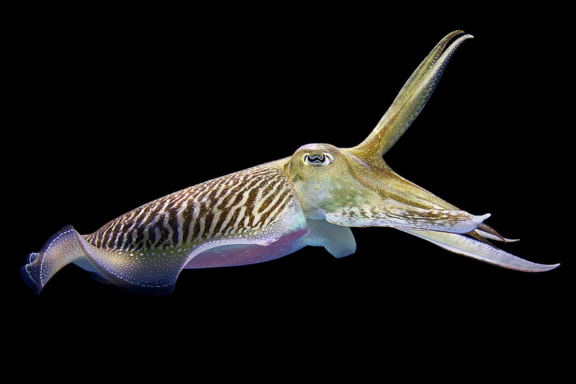
Subphyllum Conchifera
Cephalopoda (700 species)
We will find them but not in benthic samples.

Slide 18
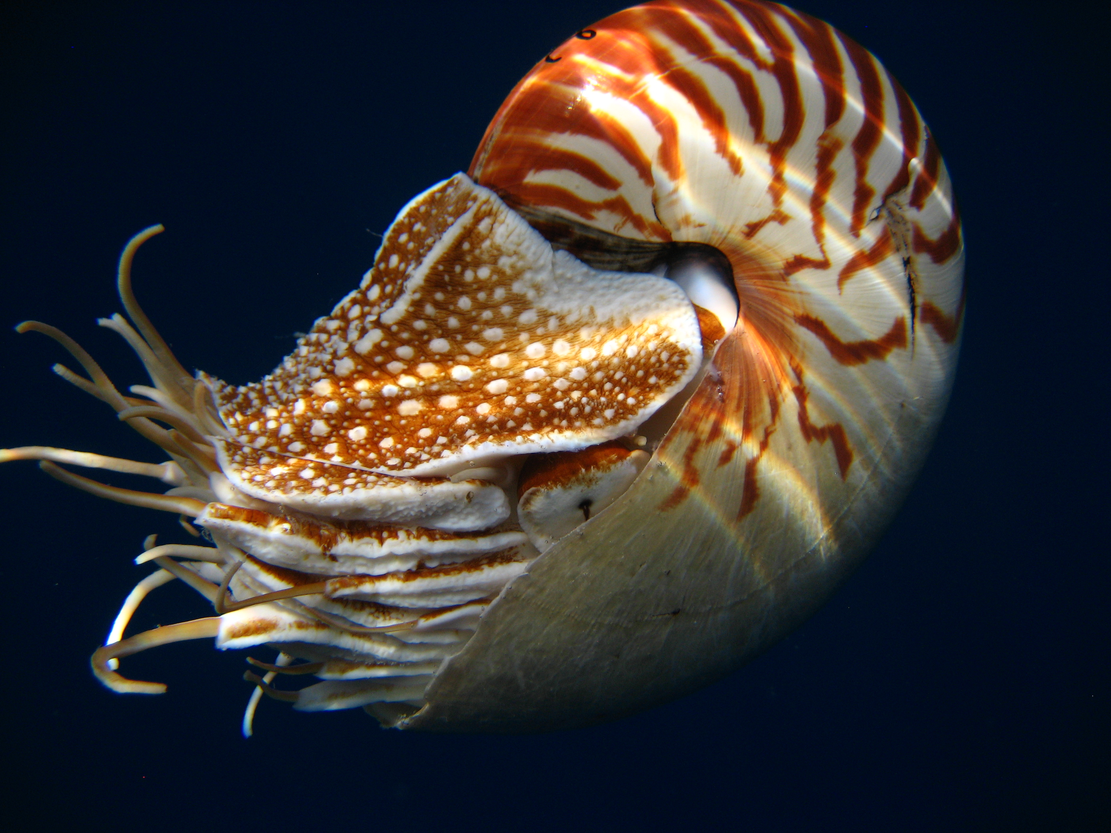
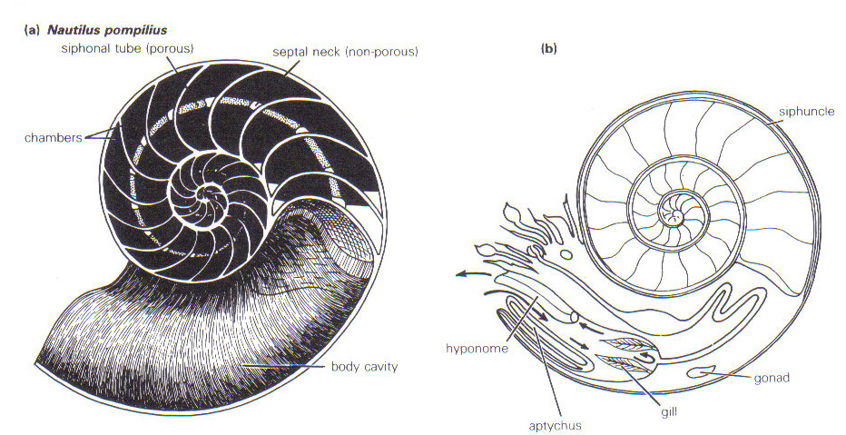
The cephalopod’s shell
Initially (in ancient cephalopods)
the shell was external

Slide 19
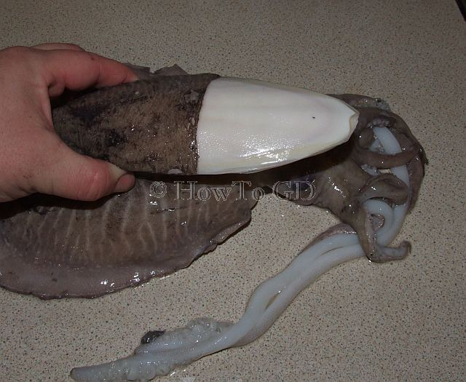
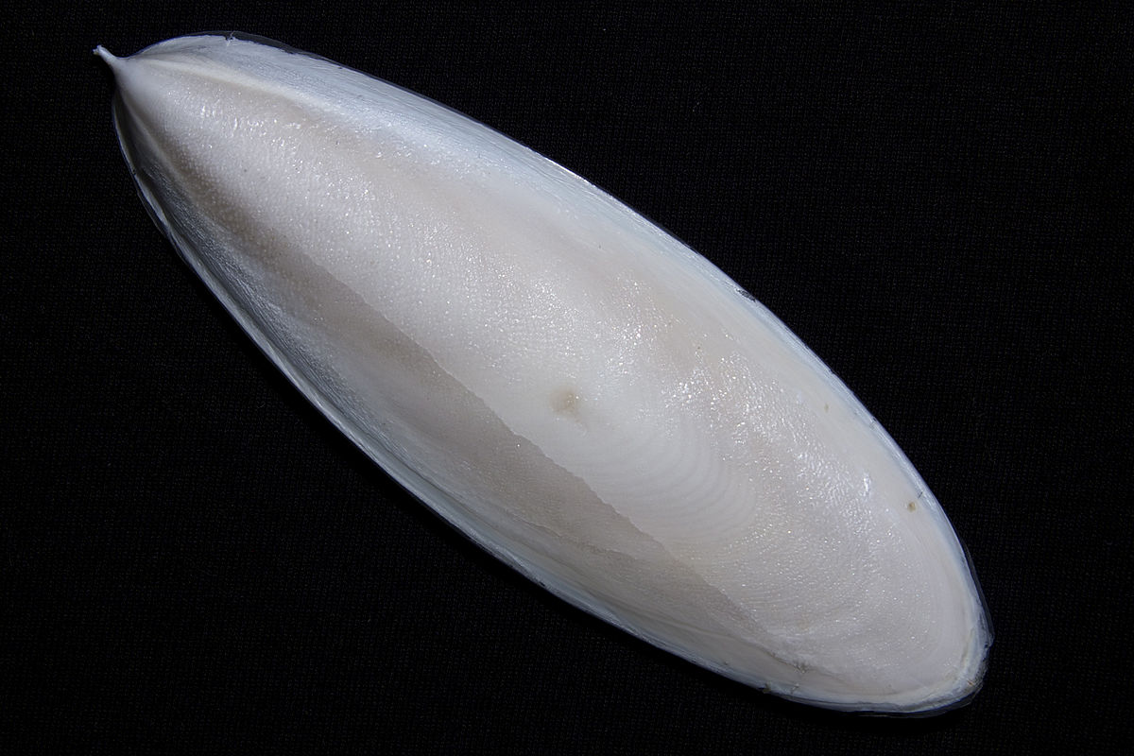
The internal shell of Cuttlefish

Slide 20
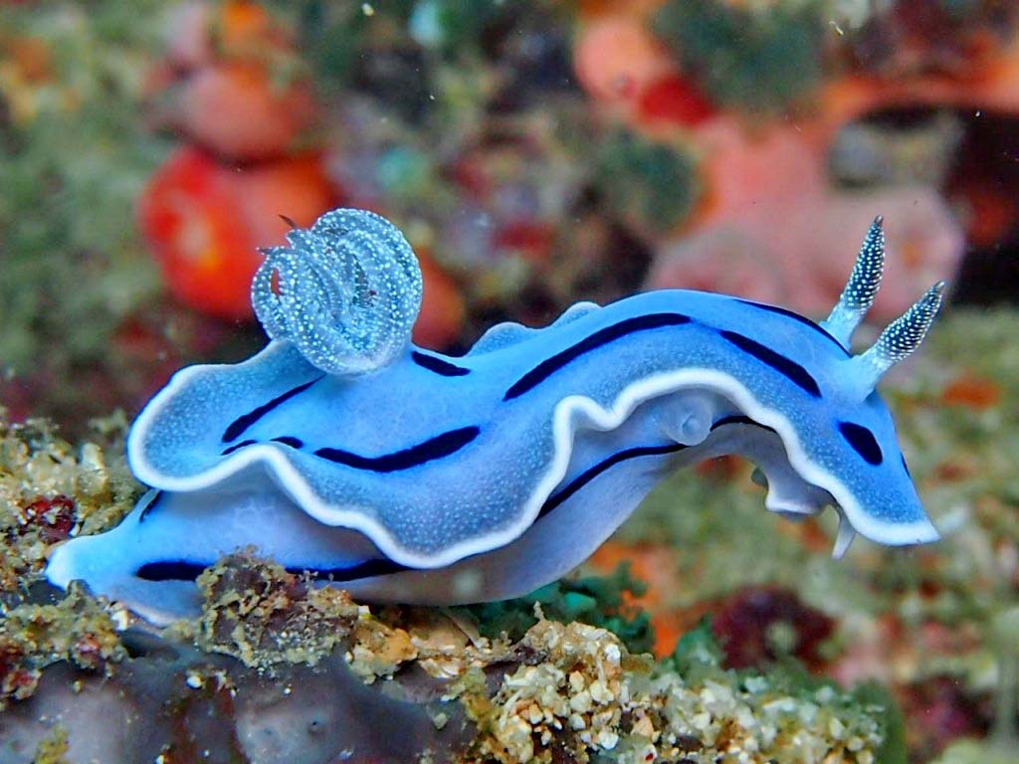
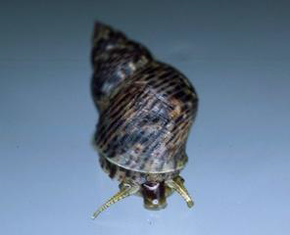
Subphyllum Conchifera
Gastropoda (40 000 species)
We will find a lot of them

Slide 21
Subphyllum Conchifera
Bivalvia (8000 species)
They are the most abundant mollusks in the Arctic seas

Slide 22
If mollusks are so different, why they are in common phyllum?

Slide 23
What is the common characters between mollusks?
Mollusk’s common body plan

Slide 24

Control question

Slide 25
Are mollusks segmented animals?

Slide 26
Initially they have some elements of metamerism.
However it could be seen in mophology of the most primitive forms.
Importantly! Their segmentation (the larval one) is differ from metamerism of polychaetes (postlarval segmentation).
_{Tryblidium}
_{Neopilina}

Slide 28
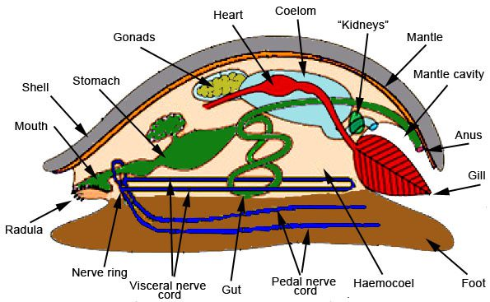
Ancestor form

Slide 29
Body plan
Mantle – the skin fold covering vesceral body part
Tentacles
Shell
Head
with mouth and radula which works like a grater
Foot

Slide 30
Body plan
Manthle

Slide 31
Body plan
Gills
Mantle cavity

Slide 32
Body plan
Metameric muscles

Slide 33
Body plan
Nervous system
(several connected ganglions)

Slide 34
Body plan
Digestive gland
Gut

Slide 35
Body plan
Pericardial cavity
(specialized coelomic cavity)
Gonads
(specialized coelomic cavity)
Heart
(specialized blood vessel)
Kidneys
Kidneys
Open blood vessels
Hemolymph freely circulates in the body cavity (hemocoel)
Open blood vessels
Hemolymph freely circulates in the body cavity (hemocoel)
Open blood vessels
Hemolymph freely circulates in the body cavity (hemocoel)

Slide 36
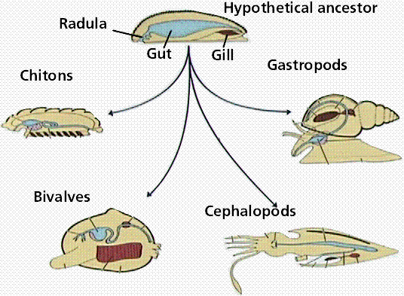
The body structure of all mollusks is a variations of the ancestral body plan

Slide 37
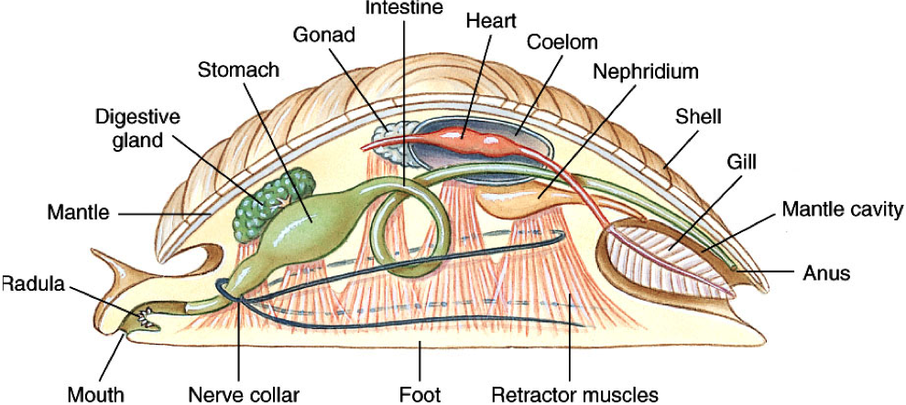
What is hidden?
3
4
5
2
6
1
7

Slide 38
What is hidden?
3
4
5
2
6
7

Slide 39
What is hidden?
3
4
5
6
7

Slide 40
What is hidden?
4
5
6
7

Slide 41
What is hidden?
5
6
7

Slide 42
What is hidden?
6
7

Slide 43
What is hidden?
7

Slide 44
What is hidden?

Slide 45
Thanks for your attention!

Slide 46
